Slide 1

Linking local knowledge and solutions globally to address the challenges of extreme heat and human health
GHHIN Core Team
Joy Shumake-Guillemot WHO/WMO Climate and Health Office
Juli Trtanj NOAA Climate Program Office
Hunter Jones NOAA Climate Program Office

Slide 2
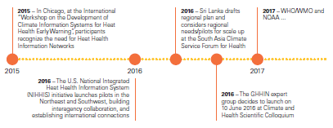
GHHIN is a response to recommendations…

Slide 3


GHHIN Addresses a Wicked Problem
the need to rapidly scale up efforts to manage the complex human health risks introduced by extreme and increasing ambient heat
the need to harmonize and improve information and opportunity sharing across the burgeoning local communities of health professionals, decision makers and scientists motivated to address this issue
The need for relevant actors from research, policy, practice, and the media to know each other and talk to each other
The need to create feedbacks to inform policy and action with available evidence and tools
Notes:
Have we framed the problem correctly?

Slide 4
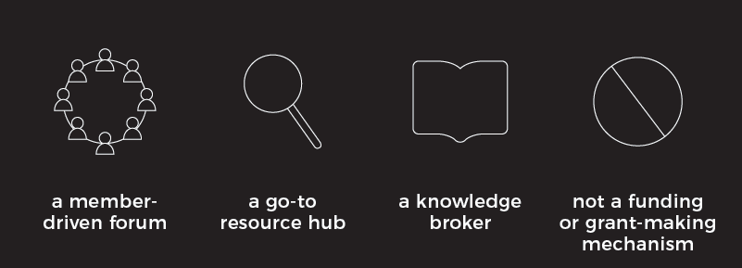
What is GHHIN?
Independent, voluntary, member-driven forum of scientists, professionals, and policymakers focused on enhancing existing efforts to address heat health risk.
GHHIN aims to create a common space to promote evidence-driven interventions, shared-learning, co-production of information, synthesis of priorities and capacity building that can empower multi-disciplinary actors to take more effective and informed life-saving preparedness and planning measures.
GHHIN seeks to be a catalyst, knowledge broker and forum for facilitating exchange and identifying needs.
Notes:
Ideally GHHIN will be a place where the latest research on extreme heat and health can be discovered and discussed… where the latest approaches to reducing vulnerability can be propagated…. and where younger members can grow their networks and learn to be effective heat health practitioners.

Slide 5

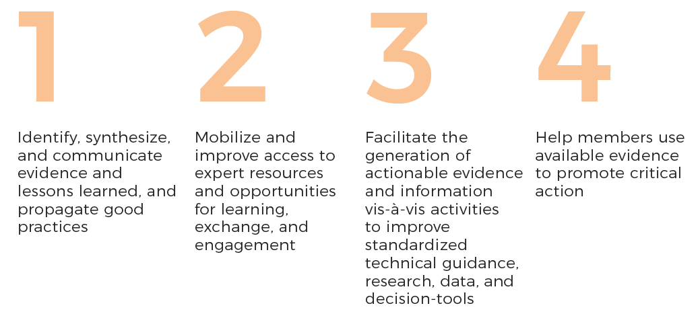
Improve the capacity of governments, organizations, and professionals to protect populations from the avoidable health risks of extreme ambient heat.

Slide 6
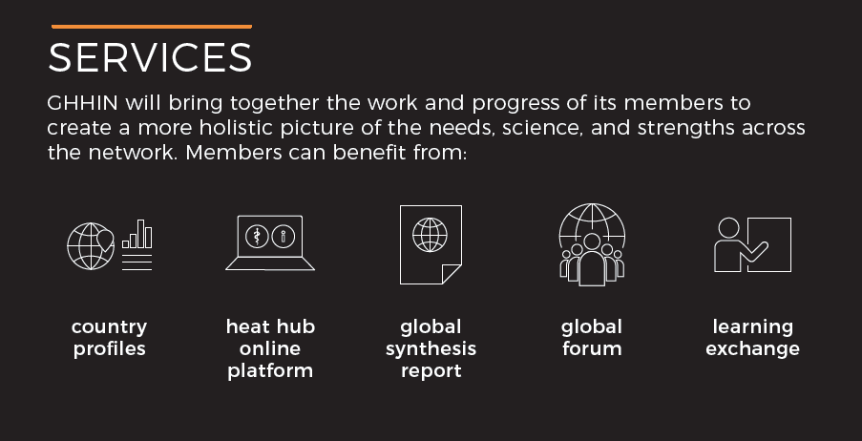
GHHIN Services for Members

Slide 7


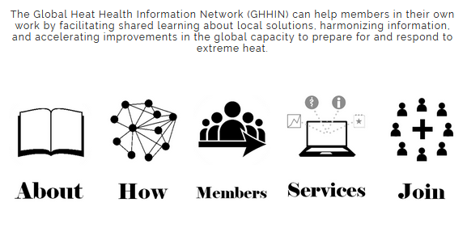












http://www.ghhin.org/

Slide 8
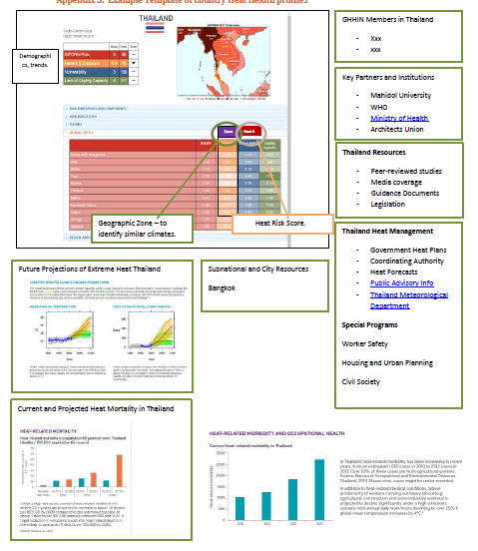

Slide 9
Not an integrated Assessment
Draws on community inputs and experience as well as scientific literature
Serve to monitor key gaps and indicators
Informs action planning for GHHIN
Science and Action
synthesis report

Slide 10
2 year international event
2018 Communication Workshops
Sharing, learning, agenda defining opportunities
Facilitate Matchmaking for mentoring and teaching

Slide 11
Our questions for you…
Have we framed the problem correctly?
What would you find of value to make it worth your while to participate?
What do you think the community (producers, consumers, facilitators of info) needs?
Where do you think you fit and can contribute to such a network?

Slide 12
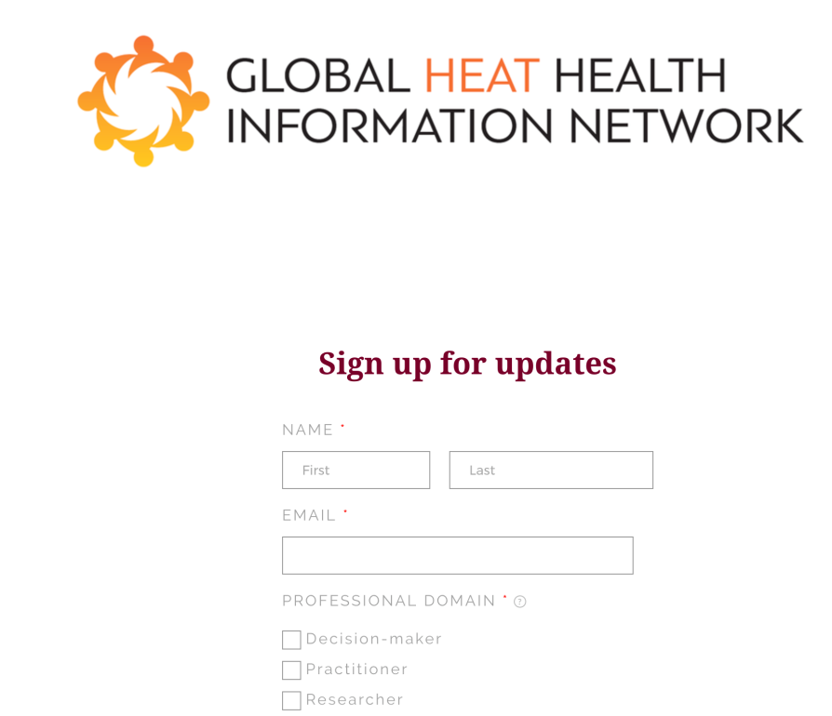
Actionable ways to get involved
Sign on to the www.ghinn.org and tell us you are interested
Give us your card
Talk to Sarah about the develop the heat decision tool

Slide 14
GHHIN Organization
GHHIN Executive Committee
GHHIN Steering Committee
Executive
GHHIN Core Team
Ad Hoc Working Groups
Virtual Expert Communities
Hazard
Expos-ure
Vulner-ability
Mixture of Expertise
Health
Met. & Clim
Soci-ology
Working
Impacts
Early Warning
Risk Mgmt.
Emerg. Mgmt.
Urb. Design
Comms
Regional Executive Committee
Region

